Slide 1



Agency Express 4.0
User Guide to Online Ordering
Log In
Tailored Shopping List
Check out
Submit Order
Appointment

Slide 2
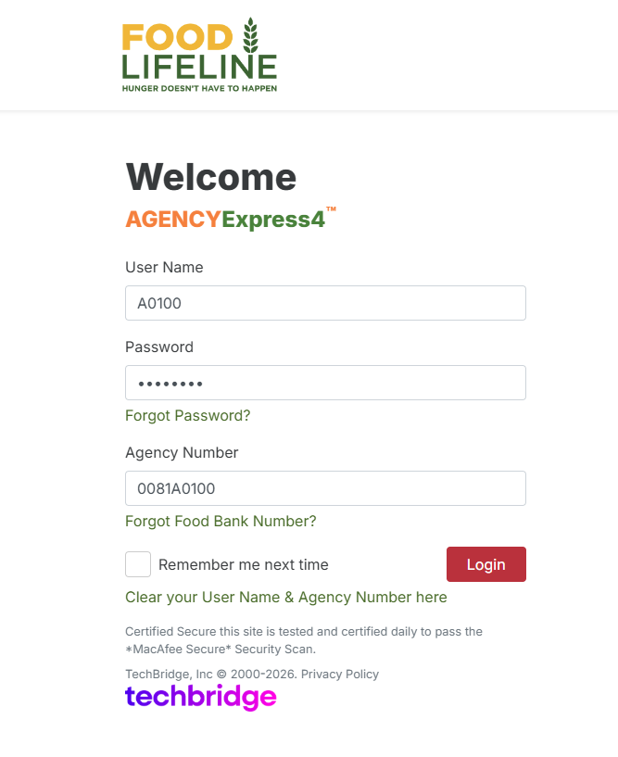
Log In
Login to Agency Express 4
To access Agency Express 4.0 visit: https://agencyexpress4.org/AgencyExpress/
A(Agency Number) | Example: A0100
Generic Password: Change12
Food Lifeline Code 0081 + Agency Number | Example: 0081A0100
CHANGES: Program Number > Agency Number
No more “p” between Food Bank (FLL) Number (0081) and Your Agency Number
Example: 0081A0100

Slide 3
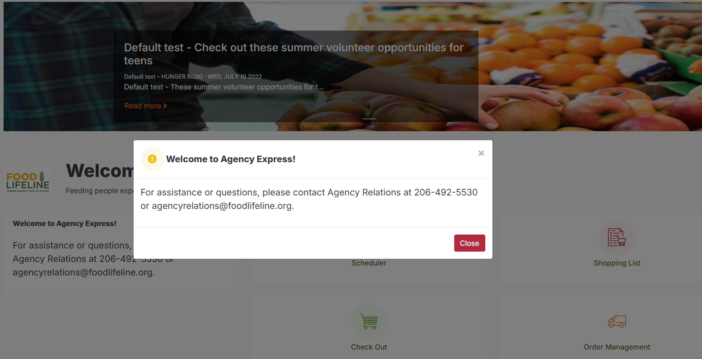
Log In
Welcome Screen
When logging in, the Shopper will see a pop-up message with Announcements. Clicking the button will dismiss the message.
Close

Slide 4
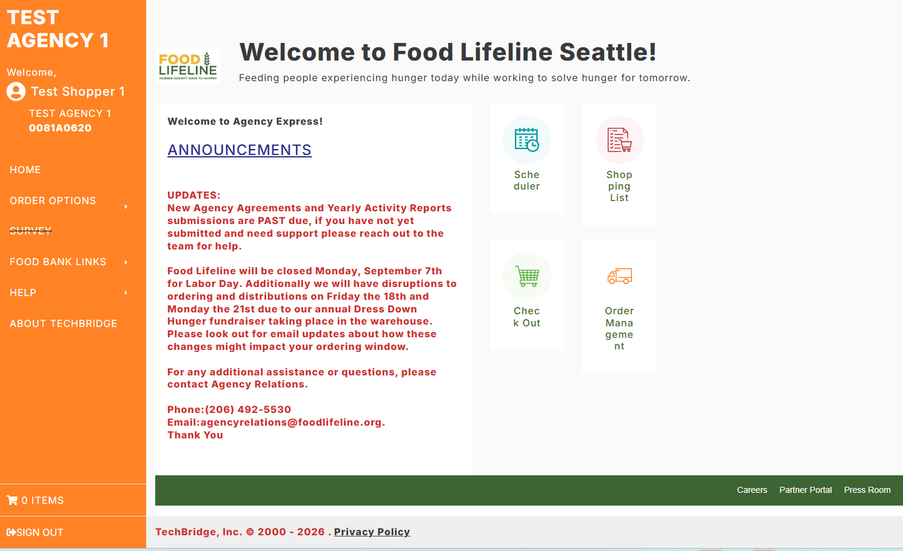
Home Screen
Navigation Pannel
Quick Links to Order Options

Slide 5
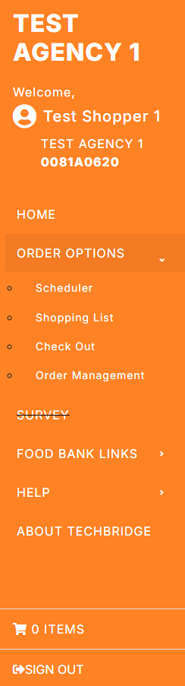
Navigation Pannel
The Navigation panel remains consistent across the website, allowing easy access to menus while browsing different pages.
Click Home at any time to return to the Home Screen.
Order options:
Scheduler: Shows only Delivery/Pickup Appointments available during the current Open Ordering window.
Shopping List: The tailored Shopping List is accessible after selecting an appointment date – and appointment dates are only visible if you are currently in your Ordering Window. This is different from the old platform, where the Shopping List was visible at all times.
Check Out
Order Management: Review and Edit Orders.
Food Bank Links: Quick access to Food Lifeline, Feeding America, WSDA and FDA websites.
Help: Links for Change Password and Contact Form.
Quick Access to Shopping Cart
Sign Out

Slide 6
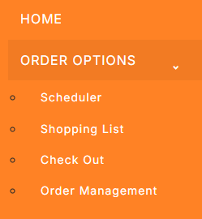
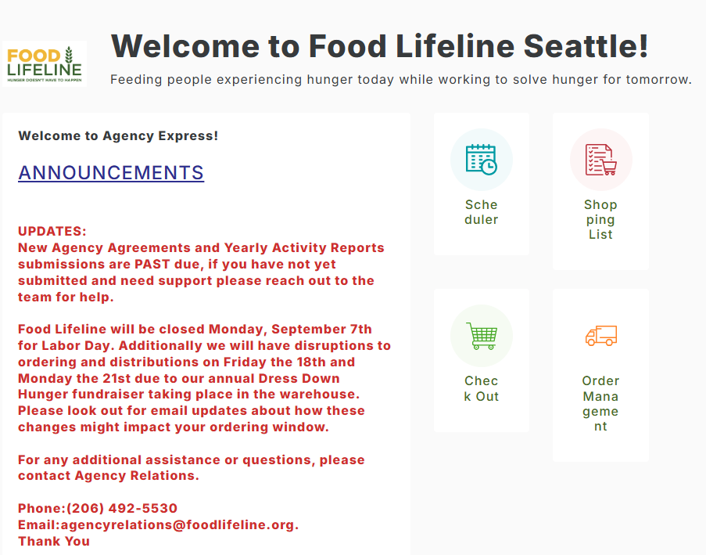
Appointment
START Shopping
Access the Shopping List
From Navigation Panel From Home Screen

Slide 7
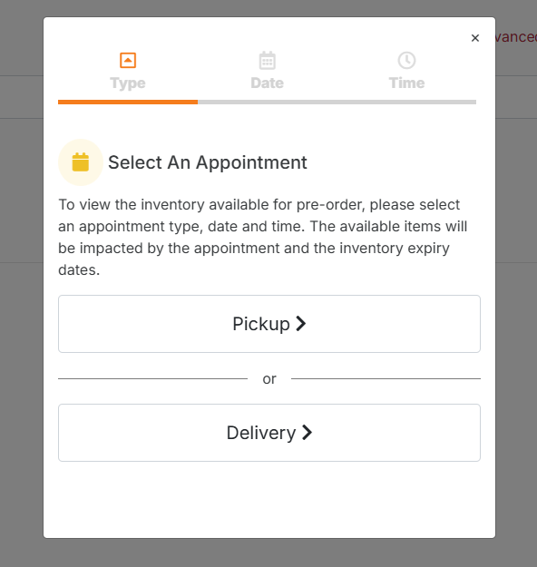
Appointment
Accessing the Shopping List
Select An Appointment
Before accessing the Shopping List, Agency Express 4.0 requires you to select an Appointment.
You will have to select Shipment type (Pickup/Delivery), available appointment dates and times on the calendar.
Your Shipment Type and Dates/Times are set up by Food Lifeline.
Notes:
Read the text on slide.

Slide 8

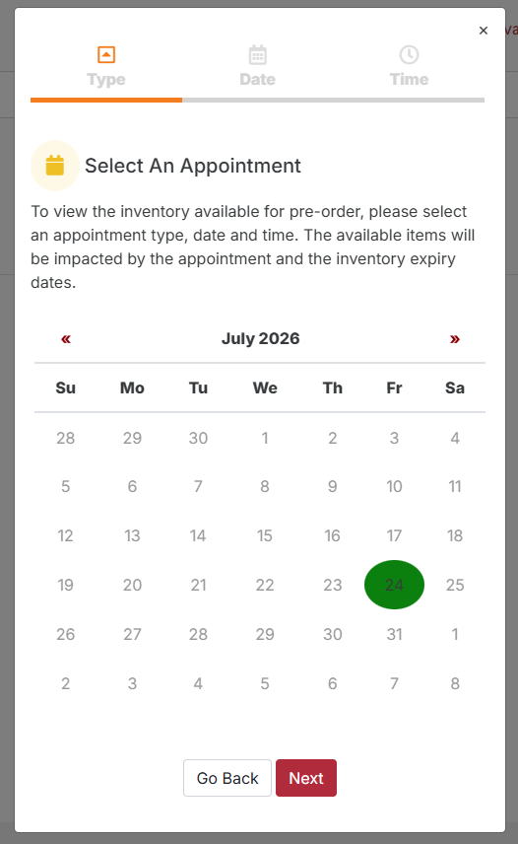
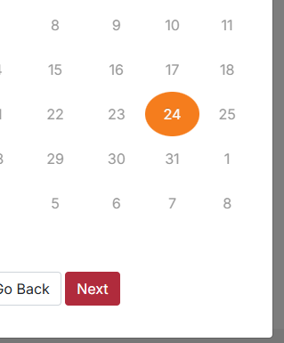

Appointment
Accessing the Shopping List
Choose the available date (in green) by clicking on it, then click on the button.
Next

Slide 9
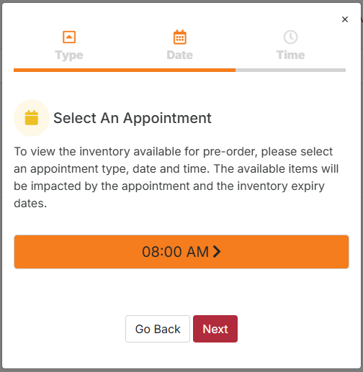
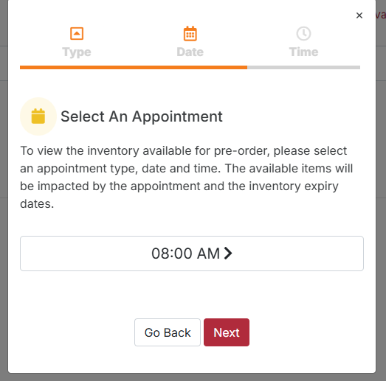
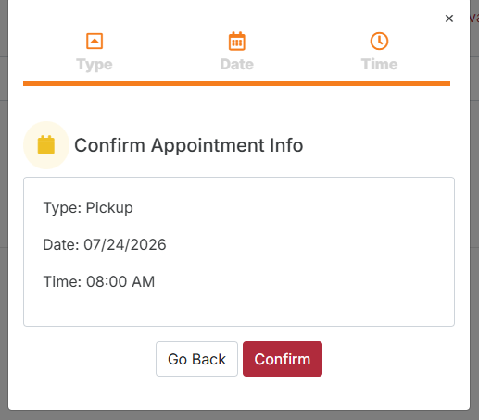
Appointment
Accessing the Shopping List
Choose the available Time by clicking on it, then click on button, and finally
Next
Confirm

Slide 10
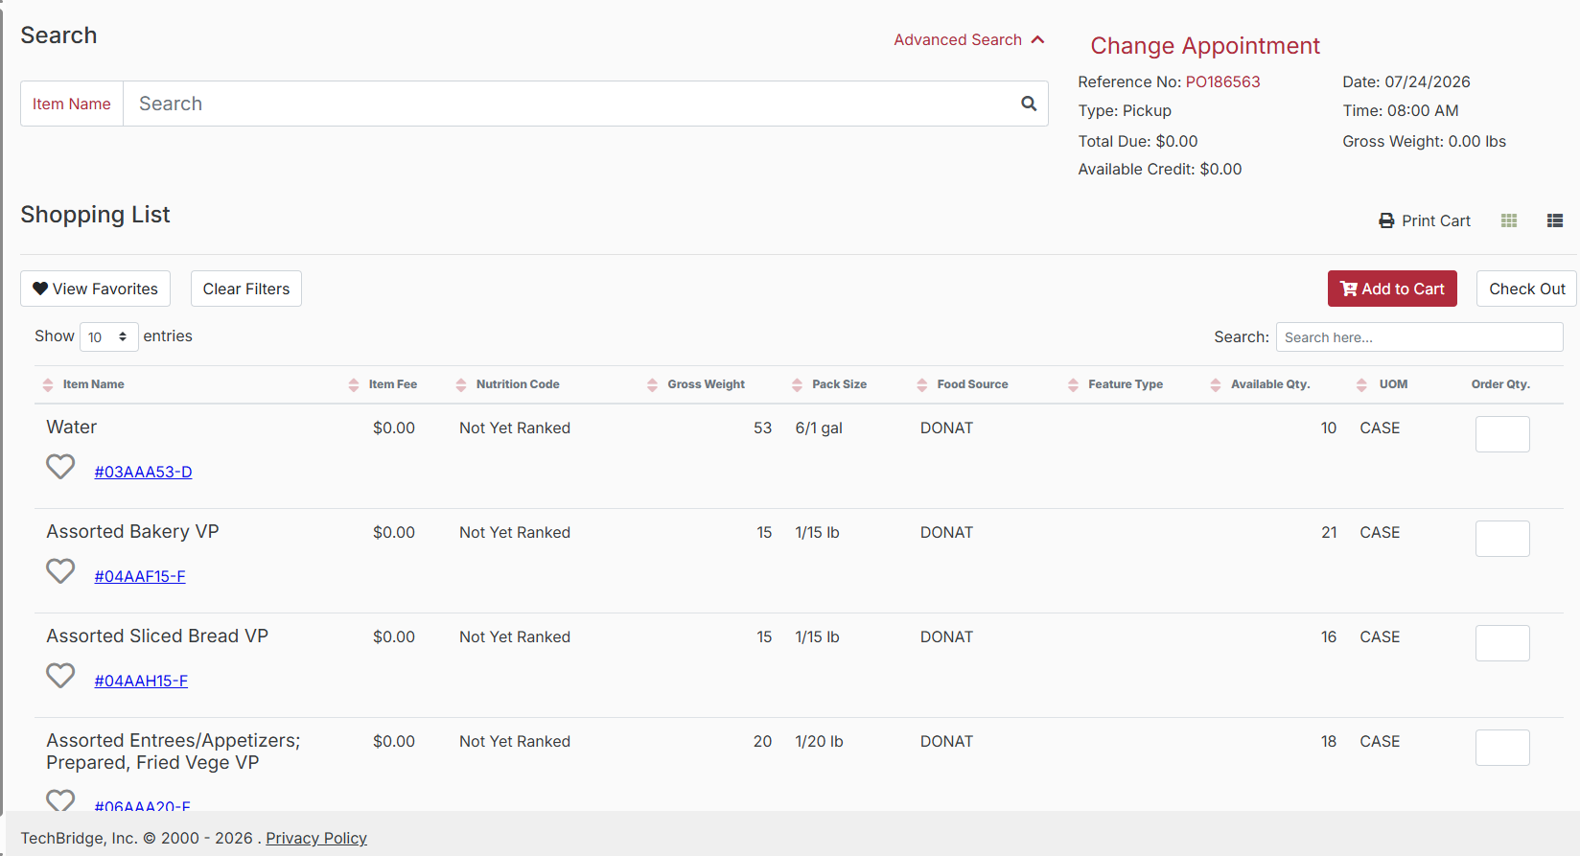

Tailored Shopping List
Adding Items
Shopping List
The Shopping List is tailored to show only product that is available and within quality and safety guidelines for your appointment day.

Slide 11
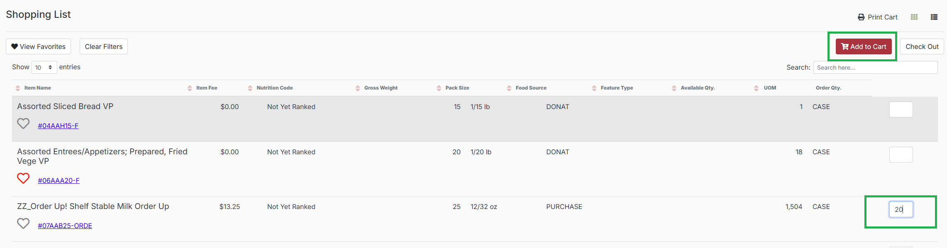
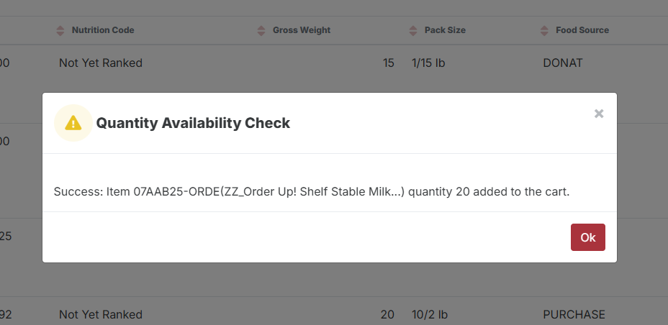
Tailored Shopping List
Adding Items
Shopping List
You can select items on multiple pages before clicking Add to Cart. Agency Express 4.0 will carry the information throughout the Shopping List pages. When you click Add to Cart, a Quantity Availability Check will pop-up to confirm the item/s has been successfully added.

Slide 12
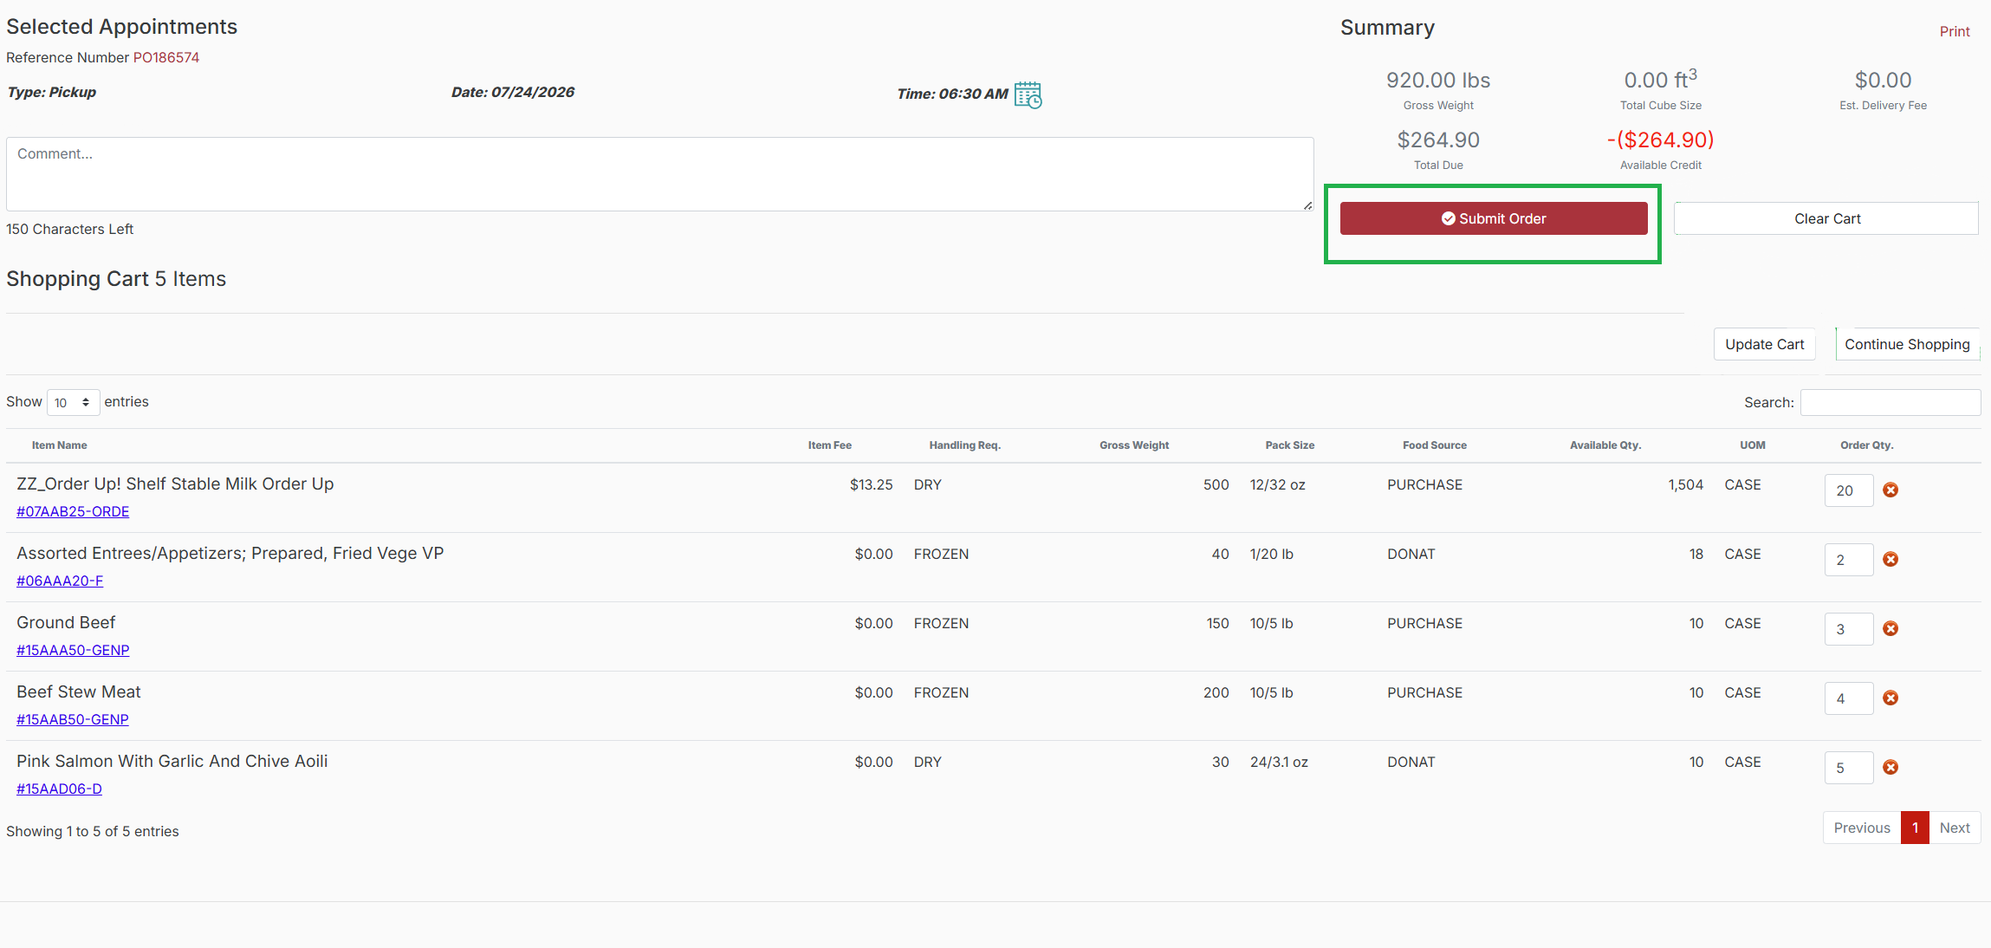
Check out
Checking Out
Add to Cart
Check Out
Submit Order

Slide 13
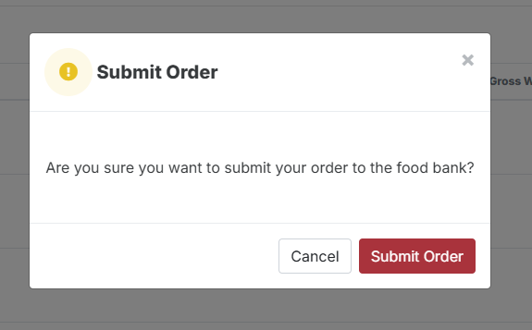
Submit Order
Checking Out
Add to Cart
Check Out
Submit Order
When submitting the cart, the Shopper will see a pop-up asking them to confirm submission.
After the Order is submitted, the user is routed to Order Management.
The Acknowledged Order status should be visible
right away.

Slide 14
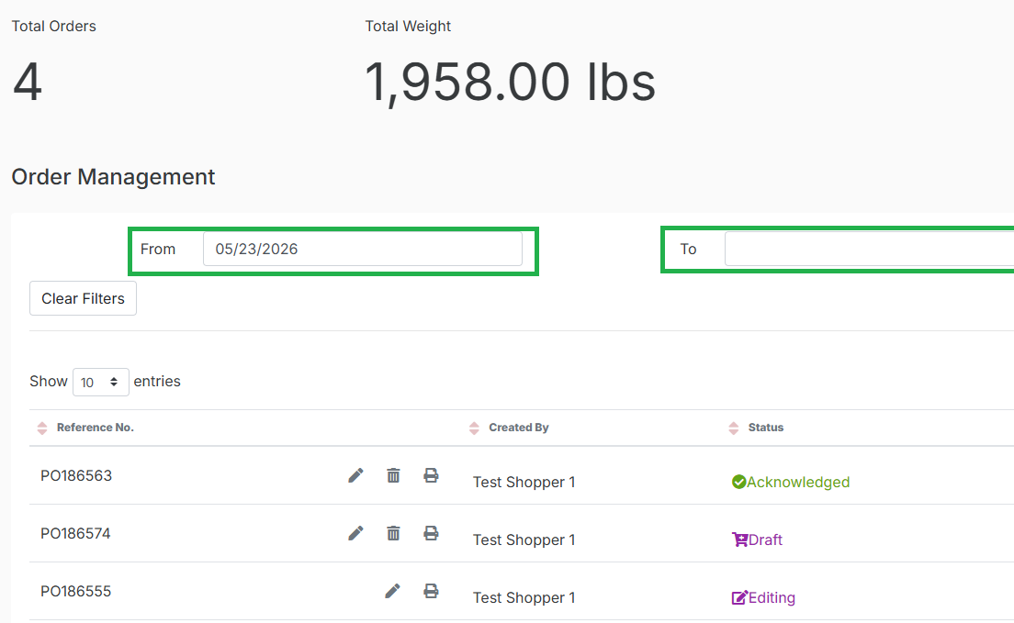
Submit Order
Order Management
Order Status
In Order Management you can locate an order by: Reference Number, From Date and To Date (based on order creation date) or Status.
Order Status:
o Draft – The order has been started but not submitted.
o Acknowledged – Food Lifeline has received the order and a confirmation email is sent to the Shopper.
o Editing – An order that is in the process of being edited by a Shopper
o Admin Editing – An order that has/is being edited by Food Lifeline admin
o Cancelled – Order that has been cancelled by the Shopper
o Rejected – Order that has been rejected/cancelled by Food Lifeline
o Released – No further changes can be made

Slide 15
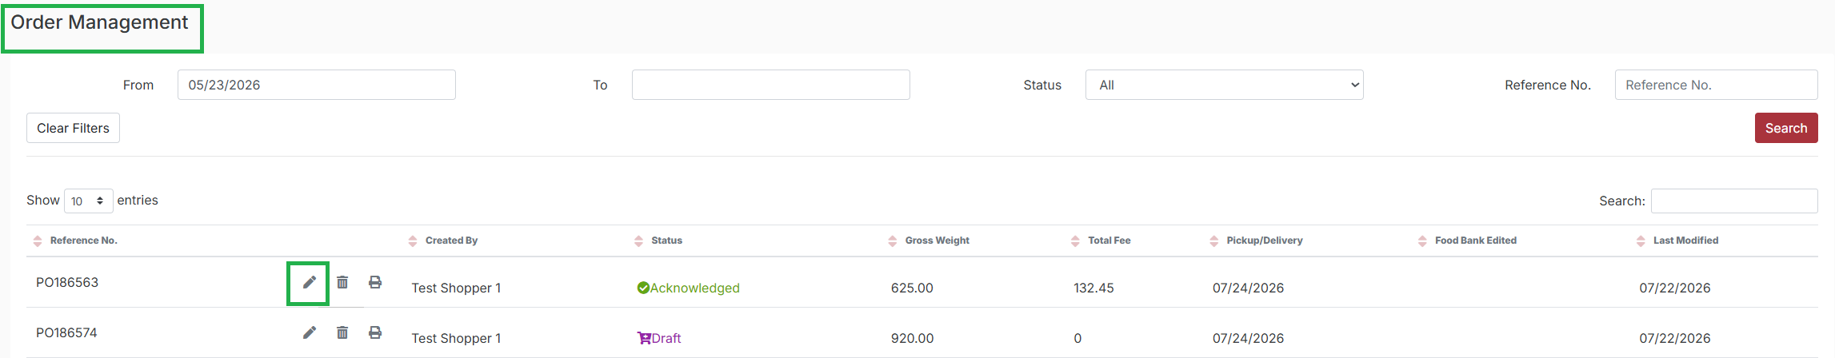


Submit Order
Order Management
Editing Orders
Editing an Order
Enter your Order through the Pencil icon. You can Add/Remove items or change quantities.
Once finished click then
Cancelling an Order
Click on the Trash Can icon on the order line to cancel a Draft or Acknowledged order.
Choose a Cancel Reason code from the drop menu.
Update Cart

Slide 16
Questions? Comments?
Please contact AgencyRelations@foodlifeline.org
Thank you!

