Slide 1


AGENCY EXPRESS 3.5
A guide to online ordering
2025

Slide 2

KEYS TO SUCCESS
Know your order window. All order windows are: ordering day @12am – 3:00 pm TWO business days prior to scheduled pickup/delivery day. For a complete list of online ordering windows, please see the last slide of this manual.
Order within your order window. Food Lifeline will be unable to process orders placed outside of the order window. Reasonable accommodations may be made for order window changes under special circumstances; if this applies to you please contact a member of Agency Relations at (206) 492-5530 as soon as possible.
Know your online ordering account login information. Store your online account information in a safe and easy-to- locate place. Make sure someone else in your organization knows where this place is in the event that you are not available during a given order window. There is space at the back of this manual to store your username, password, and program code.
Submit your cart! If you do not click “Submit Cart” after reviewing your order, Food Lifeline will not receive your order. Be sure to fully read the pop-up window that appears, and confirm that all items were accepted. If they were not, you must manually remove items from your cart and click “Submit Cart” again. Wait for confirmation that your order was submitted successfully
Having trouble ordering? Contact a member of Agency Relations. Agency Relations staff can help with any online ordering need and can be reached at: (206) 492-5530 or AgencyRelations@foodlifeline.org.

Slide 3
Tuesday
Delivery/Pickup
2 Day Order Window
Thursday/Friday
Wednesday
Delivery/Pickup
2 Day Order Window
Friday/Monday
Monday Delivery/Pickup 2 Day Order Window Wednesday/Thursday
Order Cycle Day 1 3 business days before delivery | Order Cycle Day 2 2 business days before delivery | Order Cycle Day 3 1 business day before delivery | Order Cycle Day 4 Delivery day
AE Order Day 1 (Opening) | AE Order Day 2 (Closing) & Order Processing | Order Selection | Delivery & MFP
Thursday
Delivery/Pickup
2 Day Order Window
Monday/Tuesday
Friday
Delivery/Pickup
2 Day Order Window
Tuesday/Wednesday

Slide 4
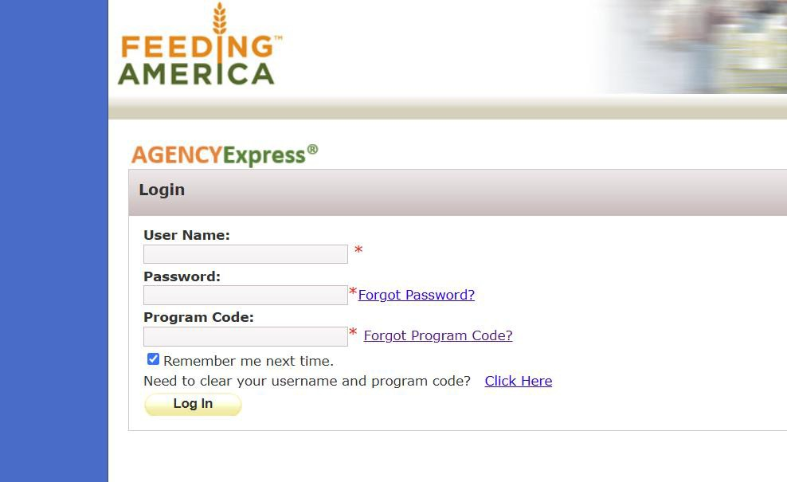
GETTING STARTED
Open A Web Browser Internet Explorer 11 Or Higher, Firefox 2.X Or Higher, Or Google Chrome
Go to www.agencyexpress3.org

Slide 5

3. Enter your login information Each agency has unique login information to access Agency Express 3.5
A0(Agency Number) EX: A0100 Password: Change12
Program Code: 0081PA0(Agency number) Ex 0081PA0100

Slide 6

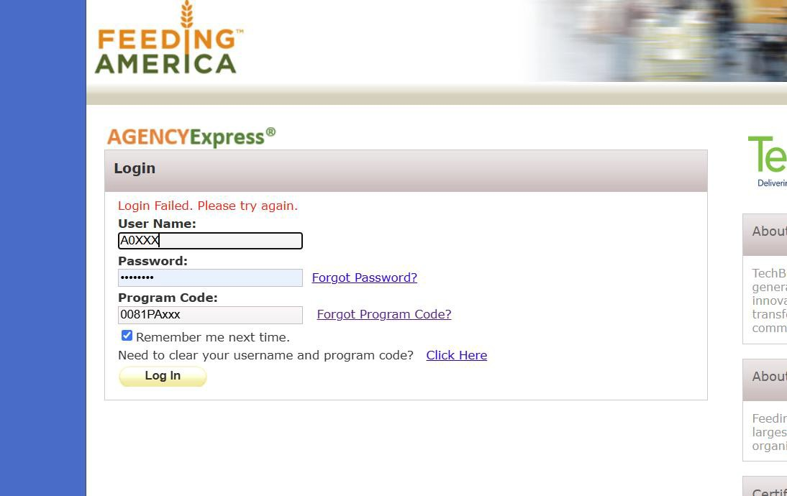


Login Failed Message
Check these items:
Is your password accurate and spelled correctly?
Were you using “O” (the letter) instead of “0” (the
number zero) in your User Name and/or Program Code?
Does the login information you used match the format of the login listed here (to the right), with your unique three -digit number substituted for the xxx’s ?
Were you using your email address as your user name? (This allows you to access the Member Section of the Food Lifeline website, but not Agency Express 3.5)
Still can’t log in? Call a member of Agency Relations at (206) 492-5530

Slide 7
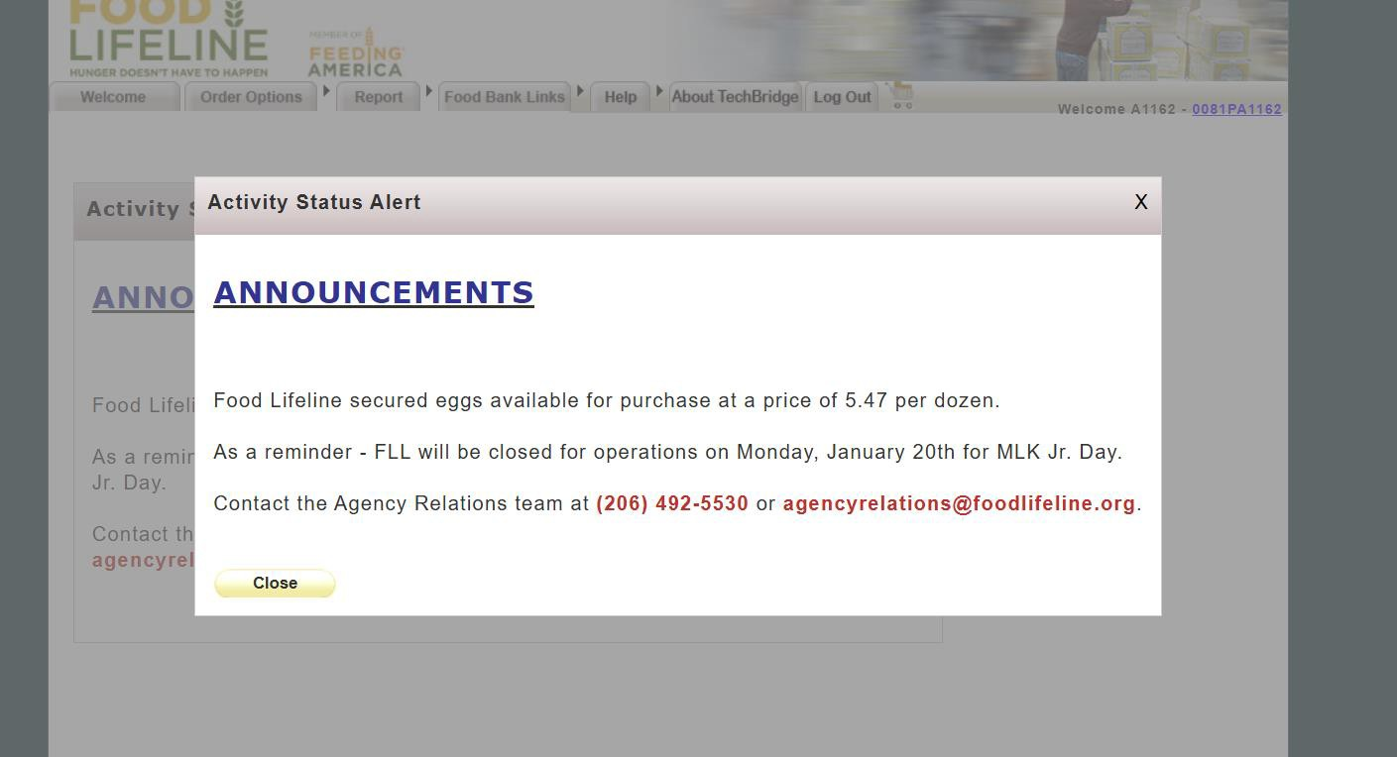


Great! You’re logged in.
Agency Express Announcements

Slide 8

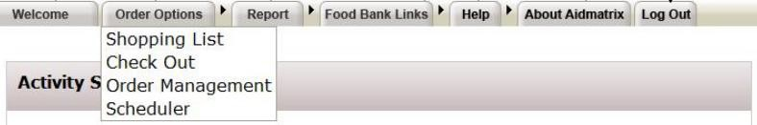
WELCOME TAB Login opens to the “Welcome” Tab This is the News & Event Page of the Food Lifeline website. You can navigate to other pages within the Food Lifeline website without leaving the Agency Express 3.0 website
ORDER OPTIONS Most of the features you use will be under this tab Click on the tab to access the page with a list of options, or drag your cursor over the tab to view the list of links within (example below). Click on any link within to visit that page.
HELP Change your password or report a problem to Agency Relations
ABOUT
AIDMATRIX Brings you to the AidMatrix external website
FOOD BANK LINKS
Informational websites, resources for your agency
REPORT Online reporting tool can be found at the member agency section of the website
LOG OUT Logs you out

Slide 9
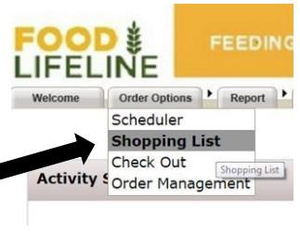
Shopping : Getting Started
To browse the available inventory, go to the “Order Options” tab at the top of the page.
Select Shopping List from the
“Order Options” menu.

Slide 10
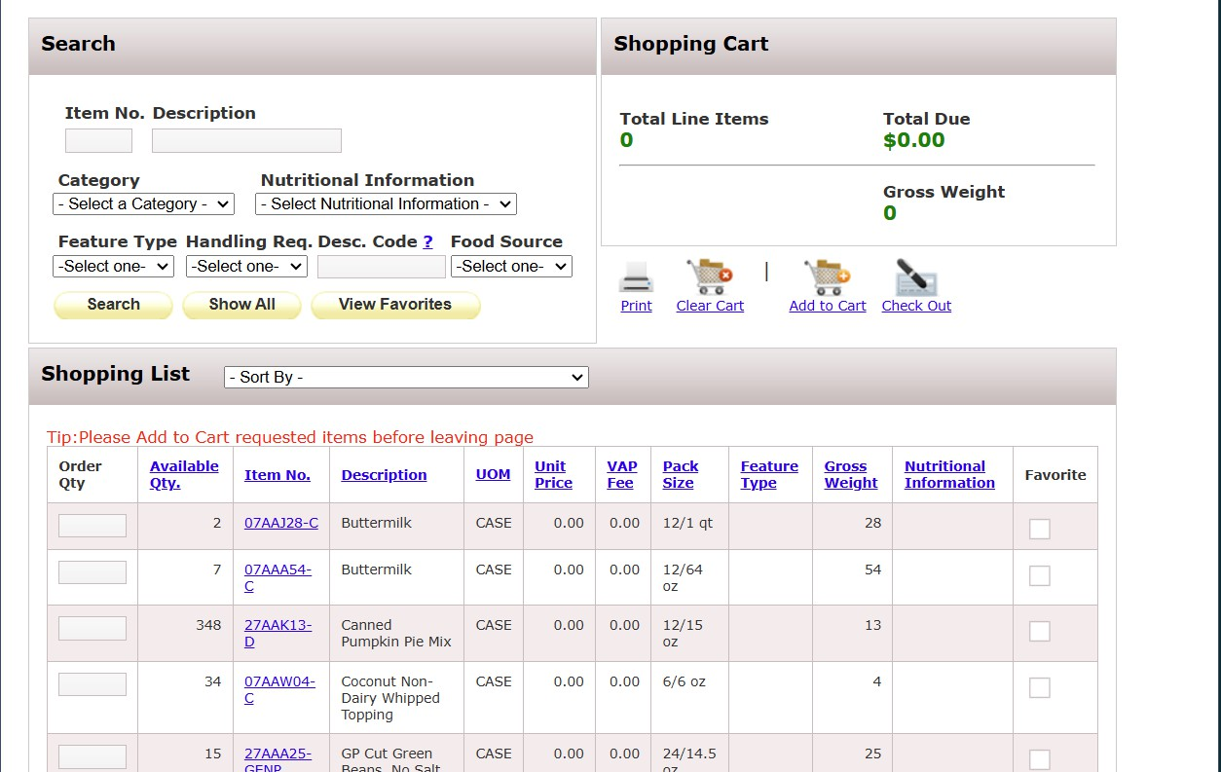
2. Next, click the “Add To Cart” button
1. Enter the quantity of each product you would like to order on the current page

Slide 11
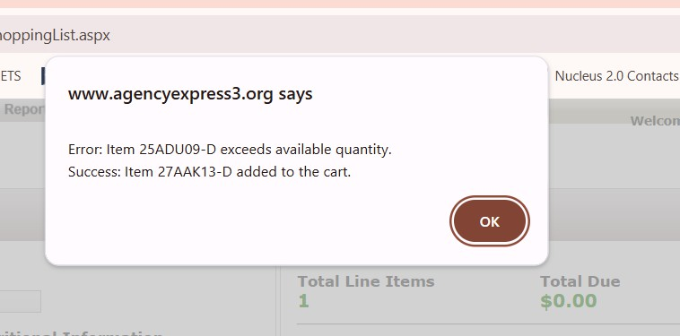
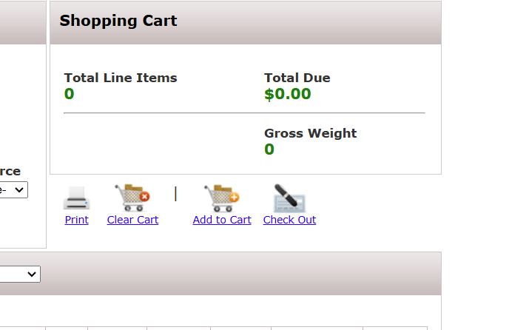
3. You will receive a confirmation message every time you add an item (s) to your cart. All items on the current page with quantities listed will be added when you click “Add to Cart”
4.When you are done shopping, click “Check Out”
Gross Weight reflects the total weight of the items in your cart. Tip: Use this to prepare for the proper amount of transportation

Slide 12
HELPFUL HINTS
Total Due reflects the value of your cart, not including any delivery fees (for agencies outside of King County)
You must click “add to cart” on each page before moving to the next page of the inventory list. If you have selected items from page one and do not add them to your cart before moving to page two, the items will not be added to your cart.
Items are NOT requested until you “submit cart”. Food Lifeline will not be notified of your item requests until this step is taken.

Slide 13
MP Only & Bulk Warning
PRODUCTS WITH “MP ONLY” IN THE DESCRIPTION ARE RESTRICTED TO MEAL PROGRAMS, FOR ONE OF THREE REASONS:
BECAUSE A DONOR HAS STATED THAT THEY WILL ONLY DONATE IF THE PRODUCT IS DISTRIBUTED TO ONLY CONGREGATE FEEDING SITES.
2. BECAUSE THE PRODUCT IS IN BULK PACKAGING (A DISTRIBUTABLE UNIT OF 15LBS OR HIGHER) AND IS A PRODUCT TYPE THAT IS DEEMED UNSAFE FOR REPACK AT THE PANTRY LEVEL (SUCH AS MEAT, LIQUIDS, DAIRY PRODUCTS).
3. BECAUSE THE PRODUCT HAS DISTRIBUTABLE UNITS THAT ARE NOT INDIVIDUALLY LABELED (NOTE: SEE THE FAIR PACKAGING AND LABELING ACT).
Products with “Bulk Warning” in the
description have distributable units of 15 pounds or greater (not including fresh produce), and thus should be ordered by food banks with caution. Please only order if you can safely repack the product into smaller units or if you can distribute as is to larger families.

Slide 14
How much should I order?
We recommend that you order only enough product for the week’s distribution.
Please also be mindful of your transportation capacity.
In the event that orders need to be cut, product will be prioritized in the following order: Purchased product (will not be removed from orders), Refrigerated and Freezer product, Dry product (will be the first to be removed from orders). When deciding which product(s) to cut, we will consider the nutritional value of the items

Slide 15
CHECKING OUT-MY APPOINTMENT
You must enter a Pickup/Delivery Date and Time before you submit your cart. When entering information into the “my appointment” box you will need to enter information from left to right. If it is entered out of order, it will not be accepted and you will have to re-enter the information. The delivery/pickup date and time are pre-scheduled by Food Lifeline, based on your ongoing pickup/delivery schedule. Click on the available option (in green). The sequence you will need to follow when completing the “My App

Slide 16
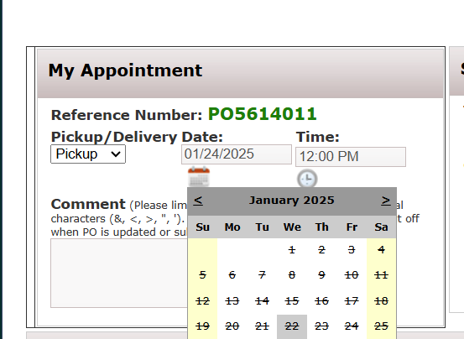
CHECKING OUT-MY APPOINTMENT
3. Select Time
1. Select Pickup or Delivery PICKUP
2. Select Date Click on the calendar and select the option highlighted in green (your next regularly scheduled date).
If you receive your Food Lifeline order via another party (Solid Ground, South King County Food Coalition, etc.) or at our Seattle Distribution Center you will need to select “Pickup”. This is true for most King County agencies.
DELIVERY If you receive product via a Food Lifeline delivery truck that goes outside of King County, you will select “Delivery”. If an incorrect selection is made, you will see no options for date and time. Please re-select the
appropriate delivery/pickup option. _{4. Use the “Comment”}
section to communicate any special instructions to the Distribution Department

Slide 17
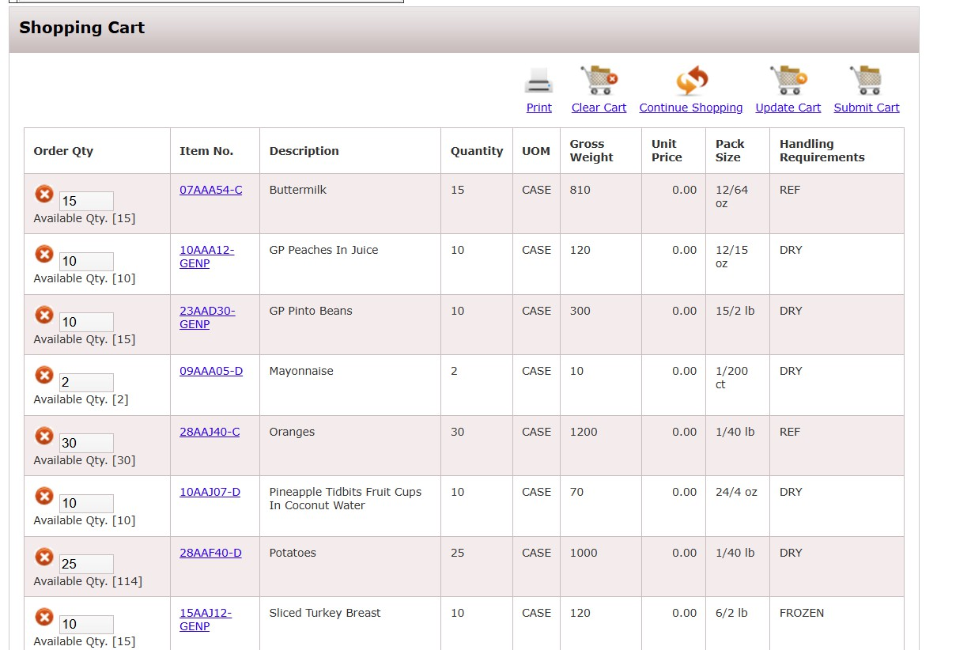
REVIEWING YOUR CART
After you have updated “My Appointment”, review your order. You can either make adjustments or submit your cart.
Click “Submit Cart” to submit
your order to Food Lifeline If
“Continue Shopping” redirects you to the shopping list without removing items from your cart
you do not click this button,
your order will not be received
and we will not know that an order was created. But wait – you might not be done yet! (see next page of manual)
You can delete an item by clicking the red circle icon
To make adjustments, change the order quantities and click on the
“Update Cart” button to update your
order.

Slide 18
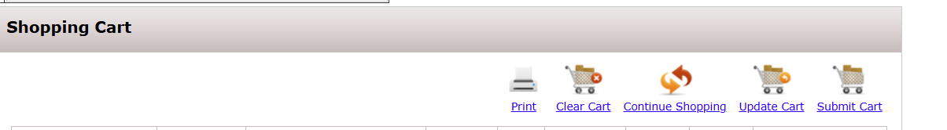
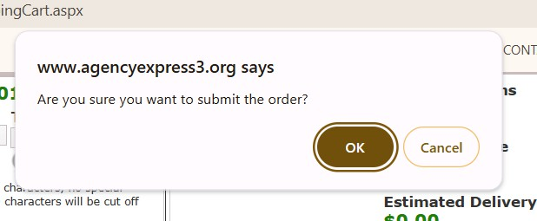
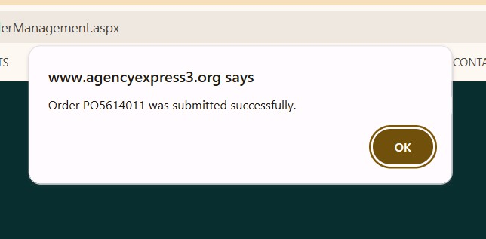
SUBMITTING YOUR ORDER
3b. **If the pop up box does not say “submitted successfully”, your order has not been submitted!** You must manually remove items from your cart where the value ordered exceeds the quantity available. Once you have done
1. Click “Submit Cart” to submit your order!
this, click “SUBMIT CART”
3a. You will then see a pop up box^{AGAIN} telling you whether your order was successfully submitted. *Read this carefully! * See 3b.
2. You will be asked if you are sure you want to submit the order, please click on the OK button to confirm

Slide 19
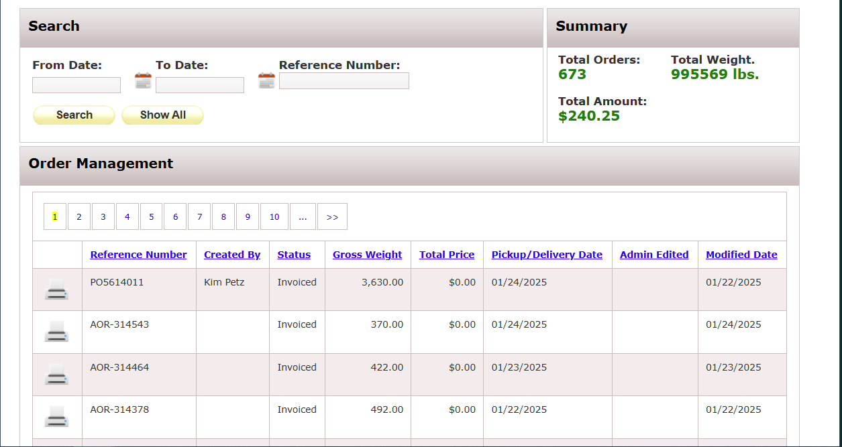


ORDER MANAGEMENT FOUND UNDER THE “ORDER OPTIONS” TAB
Search for orders or groups of orders by date range or reference number
Print a copy of your order by clicking the printer icon
Check the status of your order
4.Track the total number of orders you have placed through Agency Express 3.5, as well as the total weight and cost for those orders

Slide 20
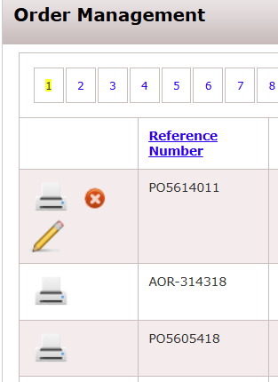


EDITING AN ORDER :
IN ORDER MANAGEMENT
1. To add on to your submitted order, click the pencil icon. This will reopen your shopping cart and allow you to add items to your order, as well as adjust the quantities of items you have already submitted.
Your order is open for editing between 12:00am-3:00pm on the order day in which it was placed.
Please Note:
There is a delay of up to 20 minutes between the time your order is first submitted and the time the pencil will be available to log in for edits.
The pencil icon will not appear if the order is not open for editing. If the status column shows “food bank only”, you may not edit your order. Edits must occur during your assigned order window.
ALWAYS re-enter your cart via the pencil icon when editing an order. If you create a new order without following this process, both orders will be lost.
To cancel your order entirely,
click the red button with the X

Slide 21
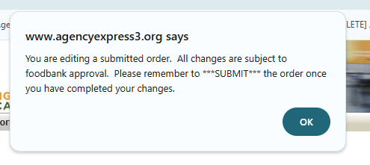


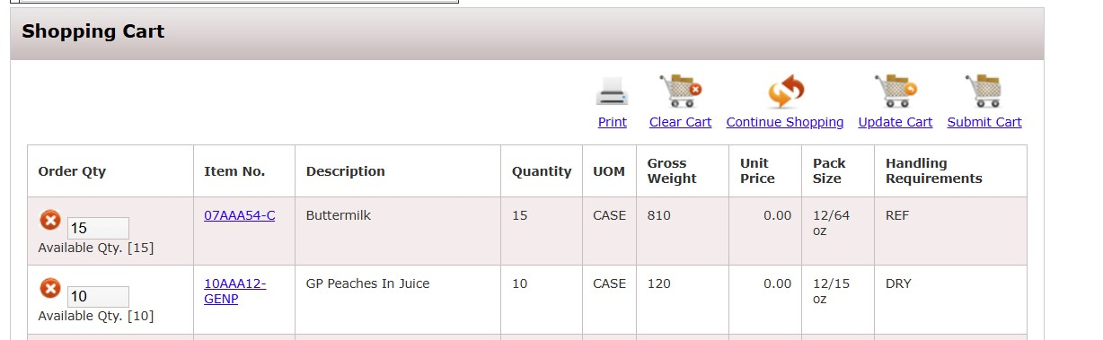

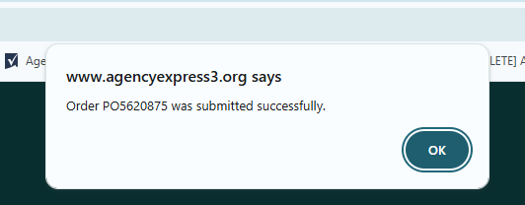
EDITING AN ORDER (continued)
After you click the pencil icon you will receive this message.
Click “OK” and you will be redirected to your shopping cart.
To do more shopping, click “Continue Shopping” and you will be redirected to the shopping list.
Shop, add or remove items, and review your cart as discussed in
previous slides
5. Remember to “Submit Cart” after editing your order! If you forget, Food Lifeline will not receive your original order or the edited order. 6. When your order is submitted successfully, you will receive this message. Click OK.
**See also, page 16 step 3b**

Slide 22
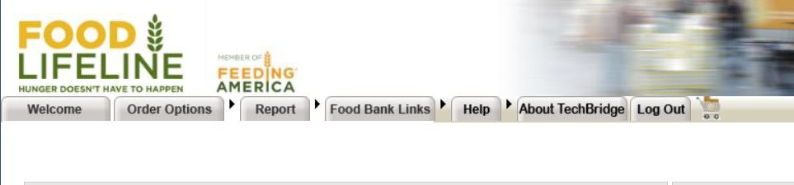

WHEN YOU ARE DONE…
Click, Log Out Tab

Slide 23
QUESTIONS? CONTACT FOOD LIFELINE
Please direct all online ordering related calls to Agency Relations so we can best serve you!
CONTACT AGENCY RELATIONS
Dial (206) 492-5530 and ask to speak with a member of Agency Relations.
Email AgencyRelations@foodlifeline.org (if your need is not urgent)
If your call is urgent and you were unable to reach a member of Agency Relations, call our reception desk at 206-492-5530 and ask for Agency Relations to be paged

