Slide 1
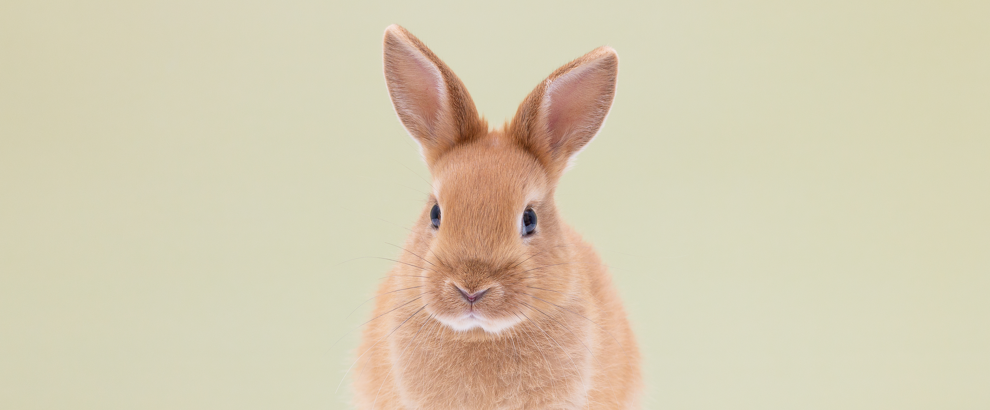
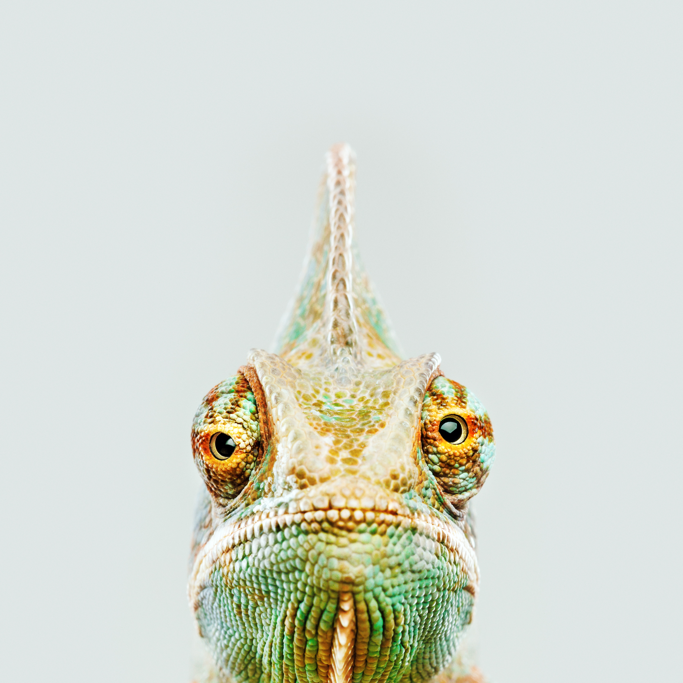
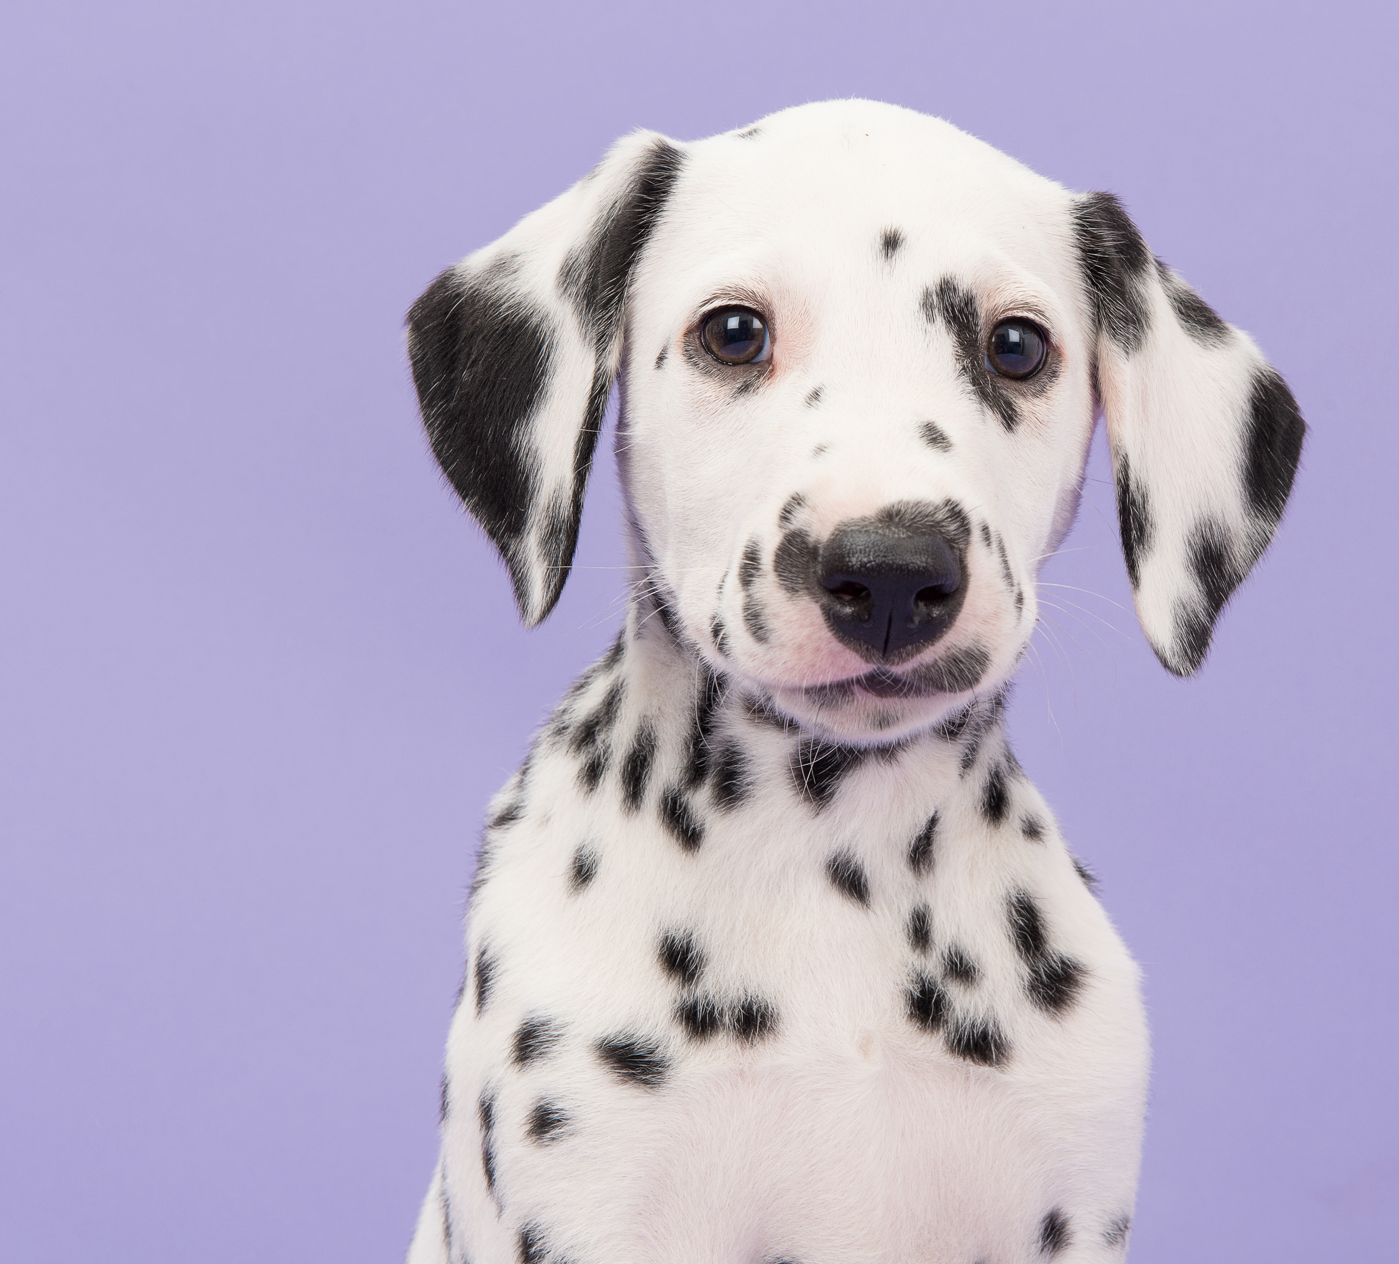
Vote for Your Favorite Photo
to benefit
Donate to vote
$1=1 vote
To vote:
Click the Donate button.
Donate your desired amount.
Type the name or number of the pet you’re voting for in the comments section before you check out. If you don’t enter a name or number, your vote can’t be counted.

